Slide 2
1. Background of the Study
Many students struggle to develop effective listening strategies because the words are still strange. They felt difficulty in recognizing words and inferring meaning from context. In addition, the results of the analysis that students faced various challenges in listening skills, such as unfamiliar accents, fast speed of speech, and new vocabulary (Astika & Kurniawan. 2020).

Slide 3
Based on the previous research, this study attempted to investigate the impacts of video-based learning on students' understanding of listening strategies and its implications for language education. the study addressed several research questions below:
What are the impacts of video-based learning on students’ understanding of listening materials?
What are the students’ perceptions of video-based learning in listening comprehension?
How is the effectiveness of video-based learning in listening strategies?

Slide 4
2. literature review
Video-based Learning provides unique features of a learning management system, enjoyable and engaging learning, and encouraging tasks that enhance students' participation, motivation, self-discipline, and autonomy in an online learning environment (Wulanjani et al., 2022). It also influenced their satisfaction and perception of learning (Robledo &Ayala, 2018). Also, the students showed positive learning experiences and perceptions when they used video on Youtube (Widiastuti, et al., 2022); understood and remembered the complex concepts better when they were exposed to a visual explanation video on YouTube (Chen & Brown, 2012).
Van Dijk and Hacker (2003) stated that there are several obstacles to online learning, such as the absence of mental readiness, materials and connectivity, digital skills, and opportunities for usage.

Slide 5
3. method
Qualitative research is used as the research design and narrative inquiry as a tool for data analysis or presentation of findings
The data collections are gathered from observation, questionnaires, and depth- interviews.
The participants are the third-semester students of Maulana Malik Ibrahim the Islamic State University of Malang who join the one English year program, they are 23 students of the Social Education and 34 students from the Islamic Elementary School Program, A class (PBA A).
In data analysis, the researchers categorize the data based on the questions in the questionnaires.

Slide 6
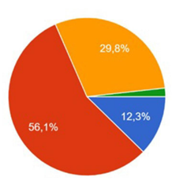
4. Figures and Tables
Figure 1
Learning through videos (YouTube) can provide comfort

Slide 7
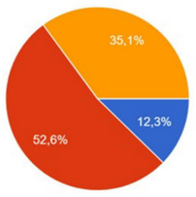
4. Figures and Tables
Figure 2
Learning through videos (YouTube) can make it easier for you to understand the materials

Slide 8
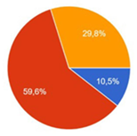
4. Figures and Tables

Slide 9
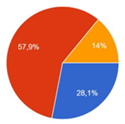
4. Figures and Tables

Slide 10
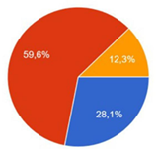
4. Figures and Tables

Slide 11
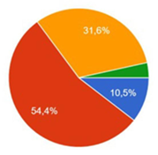
4. Figures and Tables

Slide 12
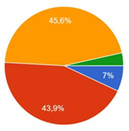
4. Figures and Tables

Slide 13
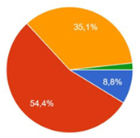
4. Figures and Tables

Slide 14
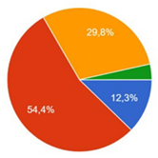
4. Figures and Tables

Slide 15
5. DISCUSSION
The findings revealed that the use of technology, namely videos shown on YouTube, has positive effects on improving students' listening skills. This aligns with Wulanjani et.al. (2022) argue that video-based learning provides unique features of a learning management system, enjoyable and engaging learning, and encouraging tasks, furthermore, enhances students' participation, motivation, self-discipline, and autonomy in an online learning environment. Moreover, learning to listen using videos on YouTube can also be a solution to the problems studied by Gultom and friends (2023) regarding difficulties in listening skills. Hence, these findings are intended to answer several of these research questions.

Slide 16
6. CONCLUSION
This study highlights the positive impact of video-based learning on students' understanding of listening strategies because 57% of university students who struggled with listening skills significantly increased their ability to understand and apply listening strategies. Also, 52,6% of students found video-based learning benefits their understanding of the materials. Additionally, 59,6% of students appreciated the effectiveness, flexibility, and accessibility of video-based learning which allowed them to learn at their own pace. They can pause, rewind, and rewatch videos as needed which requires repeated exposure to gain listening comprehension. Furthermore, the major obstacles in this study are the lack of access to devices due to the internet connectivity issues.

Slide 17
6. CONCLUSION
The findings of this study may be useful for lecturers or teachers to conduct further research to explore additional factors influencing the effectiveness of video-based learning and its long-term impact on language learning outcomes. It is suggested that future researchers expand the study by involving a larger and more diverse group of participants to see if the results remain consistent across different contexts. Comparing video-based learning with other teaching methods to determine its strengths and limitations. Lastly, investigating several strategies to look into how issues with a low internet connection might affect the learning process and outcomes, so it is suggested to find ways to make video content more accessible.

Slide 18
  THANK YOU
  MAY ALLOH BLESS US

